Slide 1


KICKSTARTER
AIM OF KICKSTARTER
Kickstarter campaigns make ideas into reality. It’s where creators share new visions for creative work with the communities that will come together to fund them.

Slide 2
WE ARE
No matter what, creators always control how the work comes together—no 100-page grant applications, no donors demanding you modify your message, no last-minute edits from investors. When backers chip in funding and help spread the word, they too become part of these independent works.

Slide 3

MARKET PROBLEM
01
02
Finding invest
Granting permission

Slide 4

OUR SOLUTIONS
Solutions
creators connect directly with their communities, putting power where it belongs.

Slide 5
DATA ANALYSIS
Crowdfunding Excel Dashboard
Crowdfunding PowerBI Dashboard
Crowdfunding Tableau Dashboard
Crowdfunding SQL Representation

Slide 6
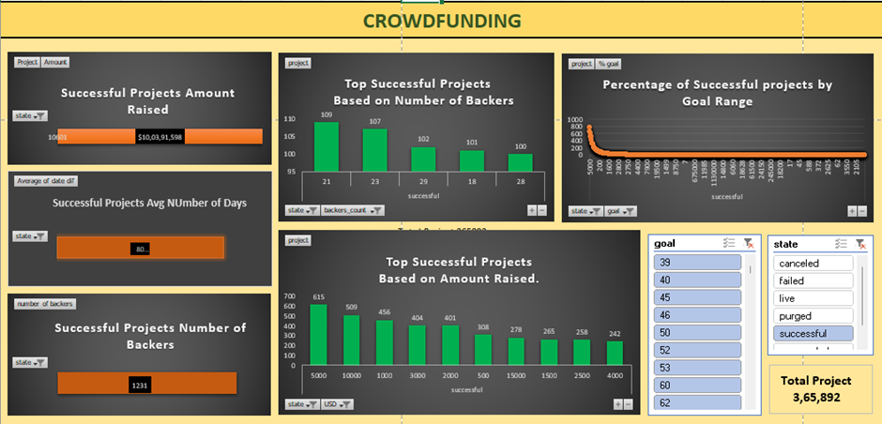
CROWDFUNDING EXCEL DASHBOARD

Slide 7
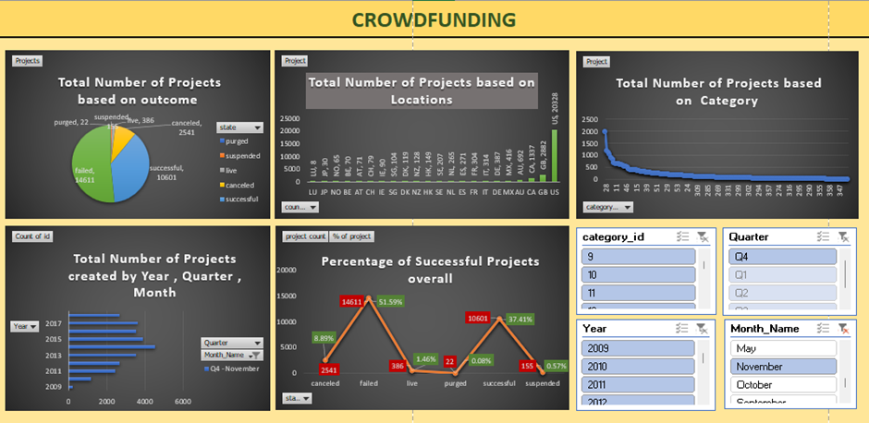
EXCEL DASHBOARD - 2

Slide 8
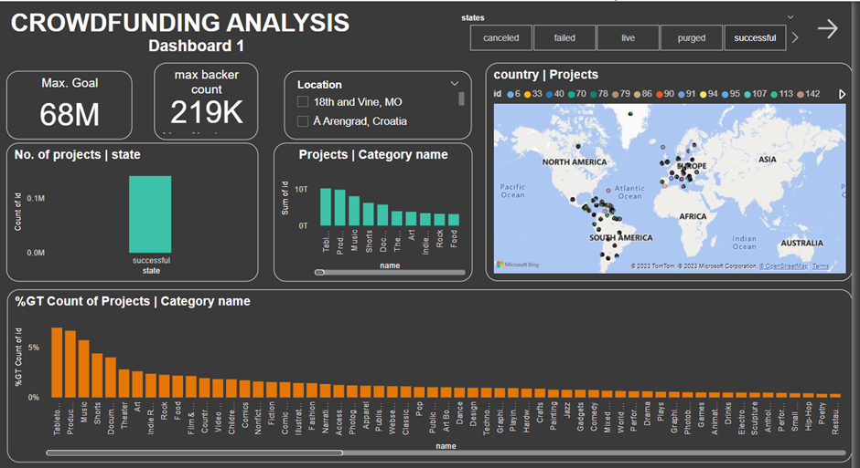
CROWDFUNDING POWERBI DASHBOARD

Slide 9
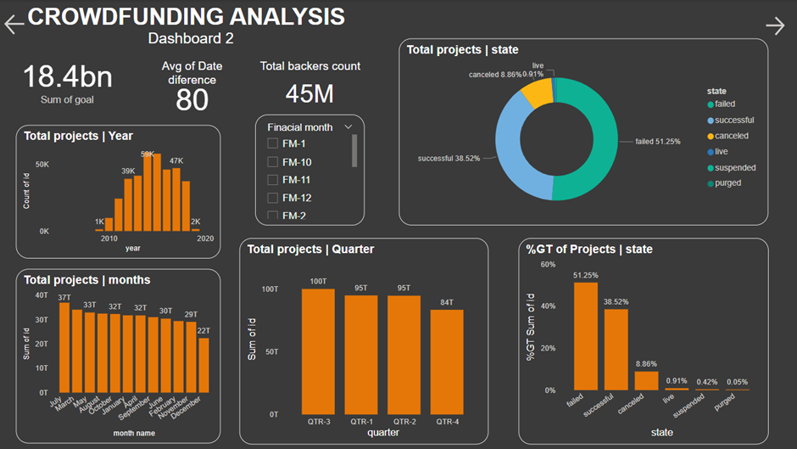

Slide 10
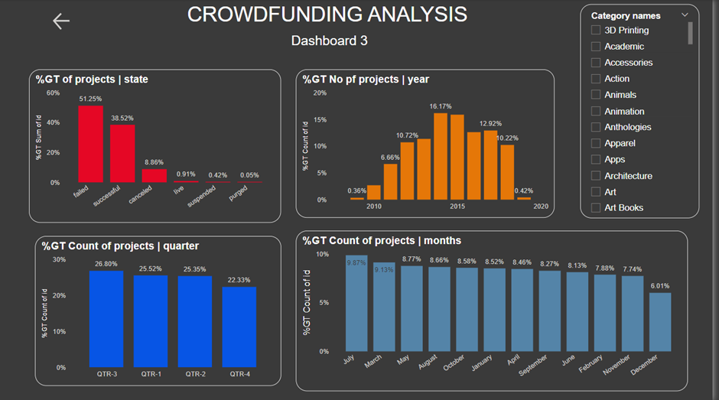

Slide 11
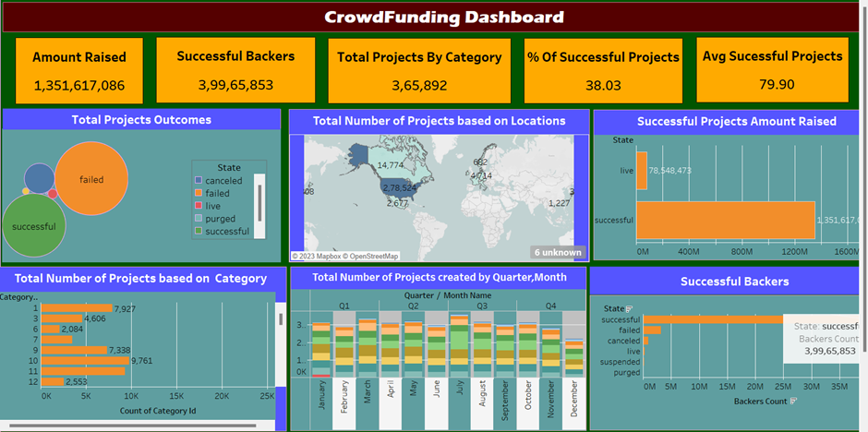
CROWDFUNDING TABLEAU DASHBOARD

Slide 12
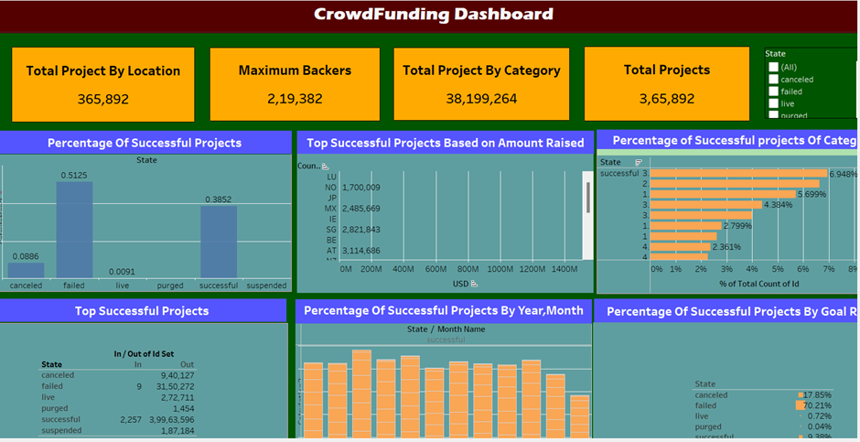
TABLEAU DASHBOARD - 2

Slide 13
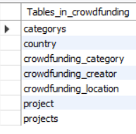
CROWDFUNDING SQL PRESENTATION
Views created:
1)categories
2)projects

Slide 14
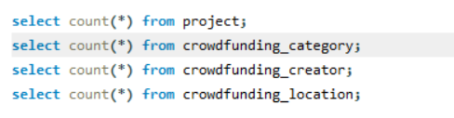
365892
RECORD COUNT IN EACH TABLE
000154
334841
023252

Slide 15








TABLE CONTENT
01
02
03
04

Slide 16
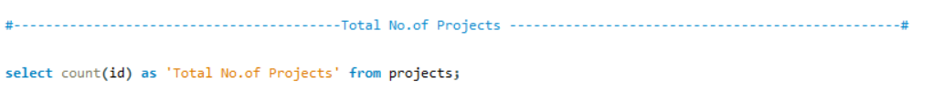

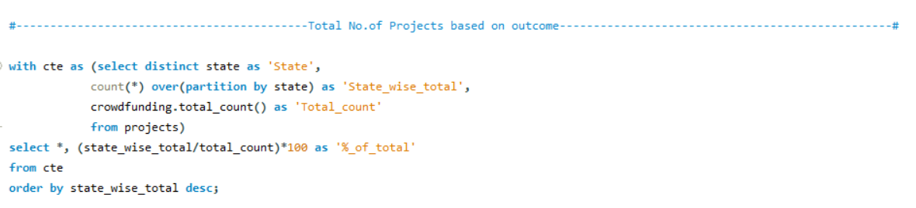
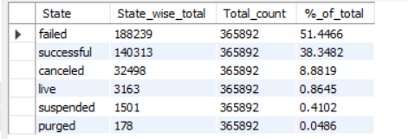
DATA ANALYSIS

Slide 17
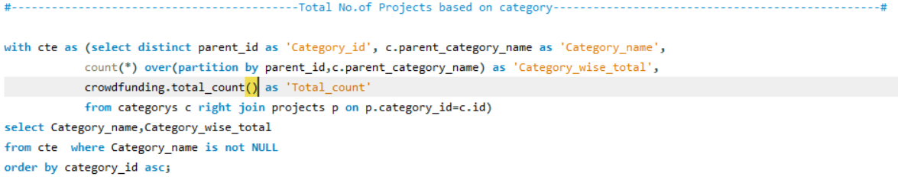
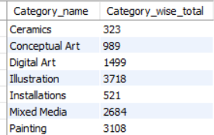
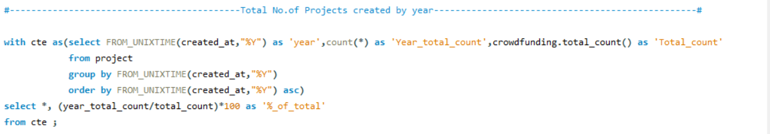
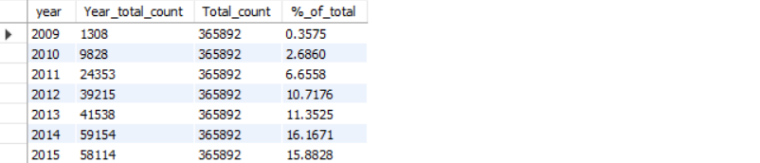

Slide 18
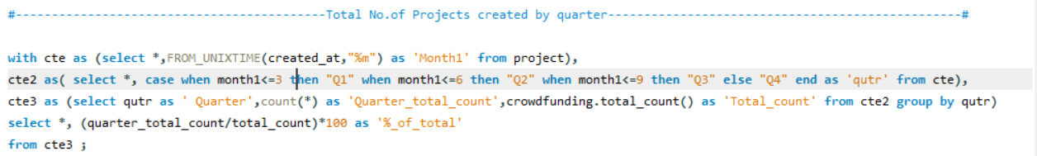
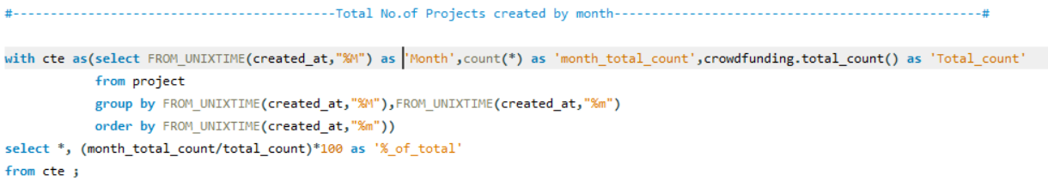
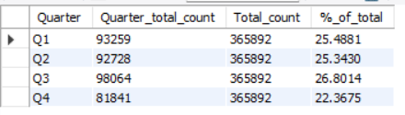
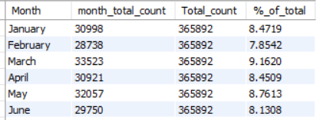

Slide 19
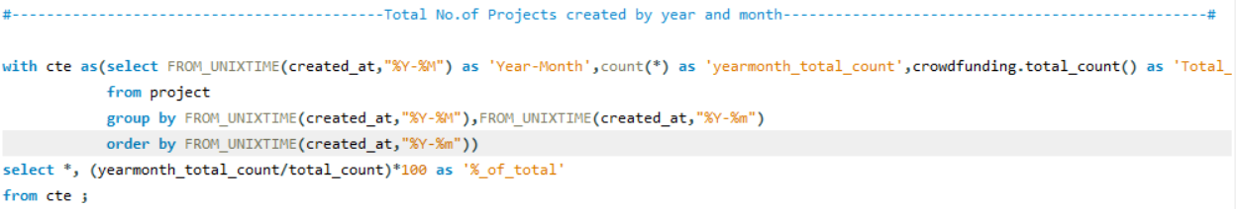
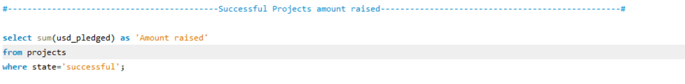
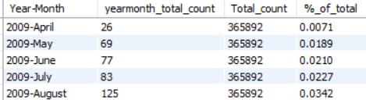
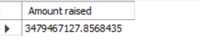

Slide 20
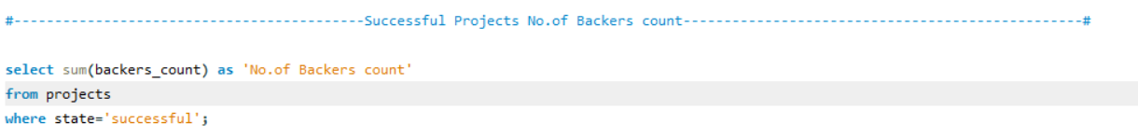
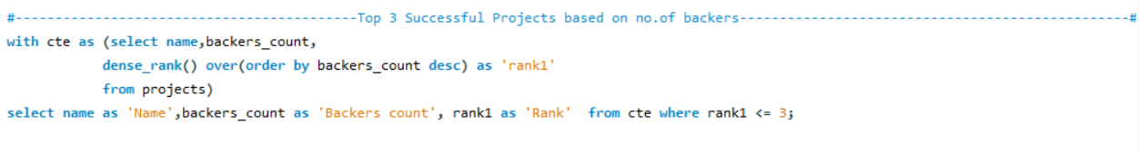
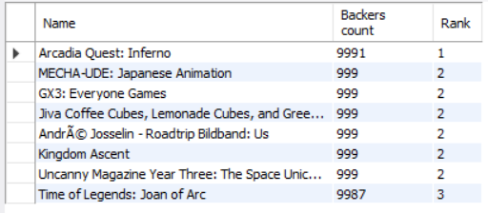
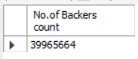

Slide 21
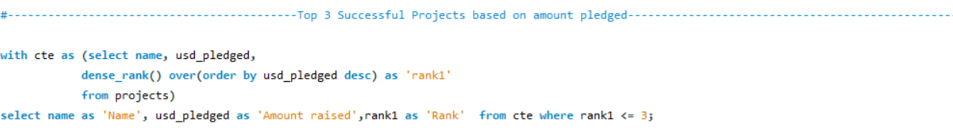
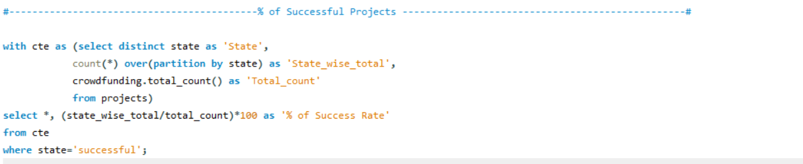
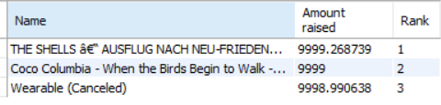
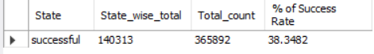

Slide 22
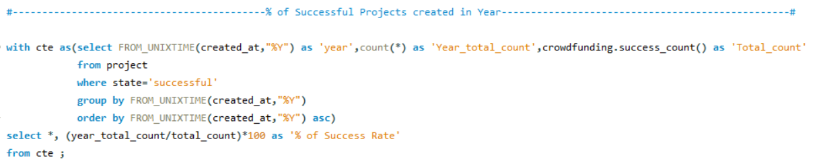
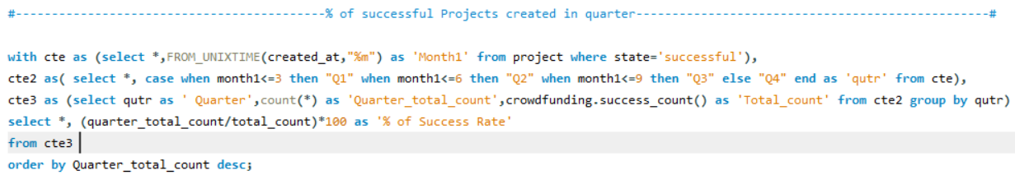
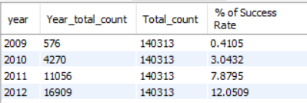
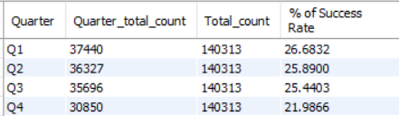

Slide 23
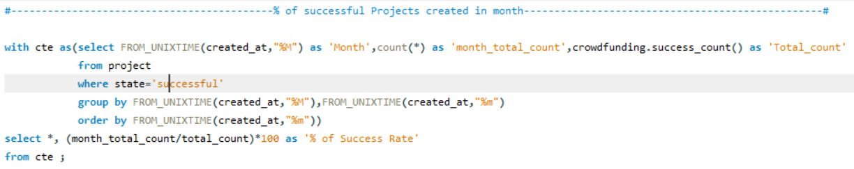
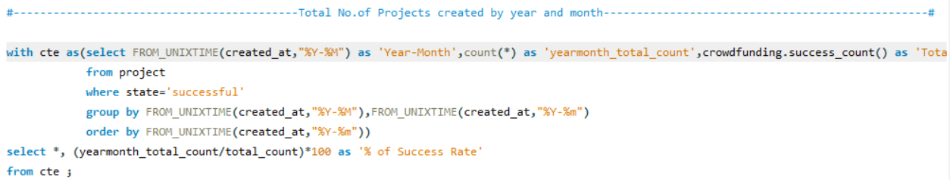
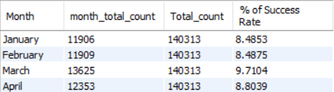
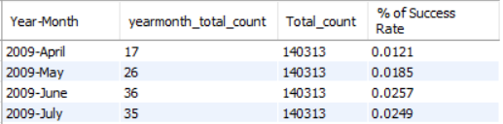

Slide 24
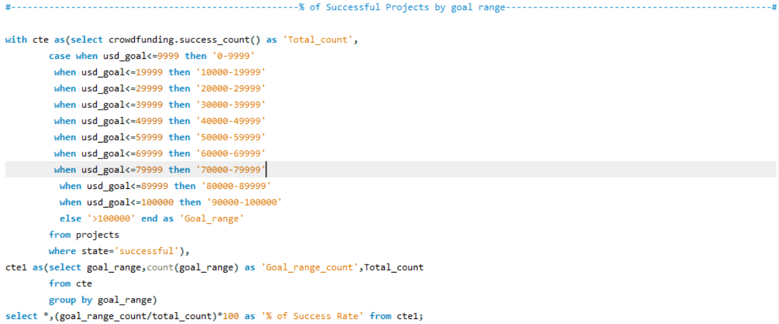
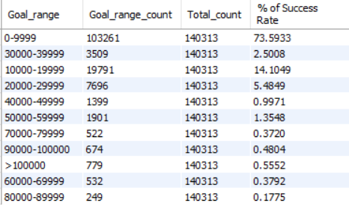
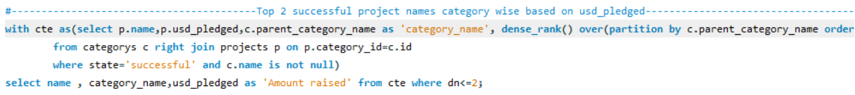


Slide 25

FINDINGS
The total goal amount is $18380 million.
The total backers are 45 million.
The average number of days taken for a successful project is 80 days.
The highest number of backers for a single project is 219k.
The highest goal amount for a single project is $68 million.
The overall successful project rate is 38.35%.

Slide 26
DATA ANALYSIS - P211
GROUP NO: 6
GROUP MEMBERS :
Harish Shetty
Arnab Ghosh
Pooja Kabare
Vajjal Keerthi
Sagar Pardale
Chetan Pujar
Surya Teeja

Slide 27

THANK YOU!

